Slide 1
Chapter 12
Templates

Slide 2
int min(int a, int b)
{
if (a<b)
return a;
else
return b;
}
template <class T>
T min(T a, T b)
{
if (a<b)
return a;
else
return b;
}
double min(double a, double b)
{
if (a<b)
return a;
else
return b;
}

Slide 3
C++ Templates
Template is an important tool for C++ to implement code reuse mechanism and is the basis of generic technology (that is, a general programming technology that is independent of data types).
Kinds of Templates
Class template
Permit the development of generic objects
Function template
Permit the development of generic algorithms
Variable template
(C++ new standard)

Slide 4
C++ Templates
C++ template is based upon the concept of type parameter，i.e. a parameter that takes a type as its value
- suppose T is a type parameter，
T i, j, k;
Declares 3 variables i, j and k
The types of the variables i, j, and k depend upon the value of T
If value of T is
int variables i, j, and k are of type int
float variables i, j, and k are of type float
user-defined variables i, j, and k are of type user-defined

Slide 5
C++ Template
Template header:
keyword “template”
one or more template
formal parameters.
general form:
template <class/typename T1, class/typename T2, int i, …>
// template header
normal declaration or definition // involving T1, T2…
Template parameter:
keyword class/typename
followed by a type parameter that will be used as a type name.
Can also use normal function-style parameters (like int i) to specify nontype parameters.

Slide 6
12.2 Class Templates
Class templates can be used to design generic classes with the same structure and member functions but different data types.
For example, stacks:
#define maxsize 100
class doubleStack{
private:
int size;
double data[maxsize];
……
}
#define maxsize 100
class charStack{
private:
int size;
char data[100];
……
};
template<typename T, int maxsize>
class Stack{
int size;
T data[maxsize];
......
}

Slide 7
12.2 Class Templates
Class templates
Allow type-specific versions of generic classes
Consists of a template header followed by a normal class definition.
Format:
template <class T1, class T2,...,int i>
class ClassName{
definition
}
To create an object of the class, type
ClassName< type1, tyoe2,...,int constant > myObject;
Example: stack< double ,100 > s1;

Slide 8
type parameters and non-type parameters
Non-type parameters refer to parameters of a specific data type. Only constant values can be passed to non-type parameters.
In the template parameter table below, T1 and T2 are type parameters, and T3 is a non-type parameter.
template<class T1, class T2, int T3>
When instantiating, you must explicitly provide a data type for T1 and T2, and specify an integer constant (such as 10) for T3, so that the template can be instantiated correctly.

Slide 9
Class template member functions
If the member functions are defined inside the class, the member functions is defined normally
If the member functions are defined outside the class, the member functions must be defined by the function templates
Class template member function definition:
template<class T, int n>
Returntype ClassName< T,n >::functionname(arglist)
{ //function body
}

Slide 10
//Stack.h
template<class T,int MAXSIZE>
class Stack{
private:
T data[MAXSIZE];
int top;
public:
Stack(){top=0;};
void push(T e);
T pop();
bool empty()
{ return top==0;}
bool full()
{ return top==MAXSIZE;}
};
template<class T,int MAXSIZE>
void Stack< T, MAXSIZE>::push(T e) {
if(top==MAXSIZE){
cout<<"栈已满，不能再加入元素了！";
return;
}
elems[top++]=e;
}
template<class T,int MAXSIZE>
inline T Stack<T, MAXSIZE>::pop(){
if(top<=0){
cout<<"栈已空，不能再弹出元素了！"
<<endl;
return 0;
}
top--;
return elems[top];
}

Slide 11
Class Template Instantiation
A template class is a class built from a class template.
The process of creating a template class from a class template is called a instantiation（实例化）. When an object is defined using a class template, causes the instantiation of the class template
When instantiating a class template, if the template parameter is a type parameter, you must specify a specific type for it; if the template parameter is a non-type parameter, you must specify a constant value for it.
Stack<int,10> MyStack;

Slide 12
Function Templates
Current scenario
We rewrite functions Min(), Max() for many different types
There has to be a better way
Function template
Describes a function format that when instantiated with particulars generates a function definition
Write once, use multiple times

Slide 13
general form:
template <class T1, class T2, …> // template header
returntype functionname (arguments of type T1/T2)
{…
}
function template also can have non-type paremeters

Slide 14
An Example Function Template
template <class T>
T Min(const T &a, const T &b) {
if (a < b)
return a;
else
return b;
}
Indicates a template is being defined
Indicates T is our formal template parameter
Instantiated functions require two actual parameters of the same type. Their type will be the actual value for T

Slide 15
Min Template
Code segment
double Value1 = 4.30,value2=2.5;
cout << Min(Value1, Value2) << endl;
// explicite instantiation : Min<double>(Value1, Value2);
Causes the following function to be generated from our template
double Min(const double &a, const double &b) {
if (a < b)
return a;
else
return b;
}

Slide 16
Min Template
Code segment
Rational r(6,21);
Rational s(11,29);
cout << Min(r, s) << endl;
//explicite instantiation: Min<Rational>(r,s);
Causes the following function to be generated from our template
Rational Min(const Rational &a, const Rational &b) {
if (a < b)
return a;
else
return b;
}
Operator ‘<‘ needs to be defined for for the class Rational. If ‘<‘ is not defined, then a compile-time error occurs

Slide 17
Function Template Instantiation
Procedure for instantiating a function template
The formal parameters in the function template signature are examined in turn
If each formal parameter involving type parameters is matched with the corresponding actual argument in the function call
a match binds the type parameter
All matches must be consistent.
only trivial promotions to produce a match are allowed
int& to const int& for example
cout<<Min(1, ‘z’)<<endl; //error!

Slide 18
Solution to template parameter mismatch
Parameter types when calling templates
Explicitly specify type parameters for function template instantiation
cout<<Min<int>(1, ‘z’)<<endl;
Use multiple template parameters
cout<<Min(1, int(‘z’) )<<endl;
template <class T1,class T2>
T1 Min(T1 a,T2 b) { return (a<b)?a:b;}

Slide 19
Overloading of template functions
A template can be overloaded by another template or by a normal function
The same rules as function overloading, require that overloaded function templates with the same name must have different formal parameter lists.
template <typename T>
inline T Min(T a, T b){
return a < b ? a : b;
}
template <typename T>
inline T Min(T a, T b, T c){
return Min(Min(a, b), c);

Slide 20
template <typename T>
inline T Min(T a, T b){
return a < b ? a : b;}
template <typename T>
inline T Min(T a, T b, T c){
return Min(Min(a, b), c);}
int main(){
const char* c1 = "hellow template override!";
const char* c2 = "hellow C++ 11!";
const char* c3 = "hellow everyone!";
cout << max(7, 42, 32) << endl;
cout << max(c1, c2, c3) << endl;
}

Slide 21
template specialization
Reasons for template specialization
Although templates can instantiate available functions or classes for various data types, it is not necessarily possible for a template to correctly handle all data types. To solve this problem, C++ allows you to define alternative versions of templates for certain data types, called template specializations.
Syntax form of template specialization
template <>
Function template or class template that replaces template parameters with specified types
No content is required in <>, indicating template specialization.

Slide 22
template <typename T>
inline T Min(T a, T b){
return a < b ? a : b;}
template <typename T>
inline T Min(T a, T b, T c){
return Min(Min(a, b), c);}
template<>
char* Min(char* a, char* b)
{
return strcmp(a, b) < 0 ? a: b;
}

Slide 23
Add common functions to templates
For a specific data type that the template cannot handle correctly, in addition to providing a specialized version that handles that type, you can also provide a normal version of the function that handles that type.
template <typename T>
inline T Min(T a, T b){
return a < b ? a : b;}
template <typename T>
inline T Min(T a, T b, T c){
return Min(Min(a, b), c);}
template<>
char* Min(char* a, char* b)
{
return strcmp(a, b) < 0 ? a: b;
}
inline char * Min(char * a, char * b){
return std::strcmp(a, b) < 0 ? a : b;
}

Slide 24
Function call resolution
To resolve a function call, compiler follows 3 steps:
Examine all non-template versions of the function, if any, for an exact match.
error if there are more than one exact match.
Examine all template functions, if any, for an exact match.
error if there are more than one exact match.
If steps 1 and 2 do not resolve the call or produce an error, then reexamine all non-template versions of the function using implicit type casting rules for regular overloaded functions.
Thus can combine both template and non-template versions of a function.

Slide 25
Non-Type Template Arguments
Can use non-type parameters in templates
Treated as const
template <typename T, int N>
T max1 (T arr[N])
{ T ans = arr[0];
for (int j = 1; j < N; j++)
ans = (ans > arr[j]) ? ans : arr[j];
return ans;
}
int main()
{ int k = 5, j = 2;
int a[] = {1,2,3,4,5,6,7};
cout<< max1<int,5>(a)<<endl;
cout<< max1<int,k>(a)<<endl;
cout << max2(a,7) << endl;
cout<< max2(a,k)<<endl;
return 0;
}
template <typename T>
T max2 (T arr[],int N)
{ T ans = arr[0];
for (int j = 1; j < N; j++)
ans = (ans > arr[j]) ? ans : arr[j];
return ans;
}
//error

Slide 26
Templates and friends
Friendships allowed between a class template and
Global function
Member function of another class
Entire another class
friend functions
Inside definition of class template X:
friend void f1();
f1() a friend of all template classes
Template<class T1>
friend void f2( X< T1 > & );
f2( X< int > & ) is a friend of X< int > only. The same applies for float, double, etc.
template<class T>
class X

Slide 27
Templates and friends (II)
friend void A::f3();
Member function f3 of class A is a friend of all template classes
Template<class T1>
friend void C< T1 >::f4( X< T1 > & );
C<float>::f4( X< float> & ) is a friend of class X<float> only
friend classes
friend class Y;
Class Y is a friend of every template class made from x
Every member function of Y is a friend of every template class made from X
friend class Z<T>;
Class Z<float> is a friend of class X<float>, etc.

Slide 28
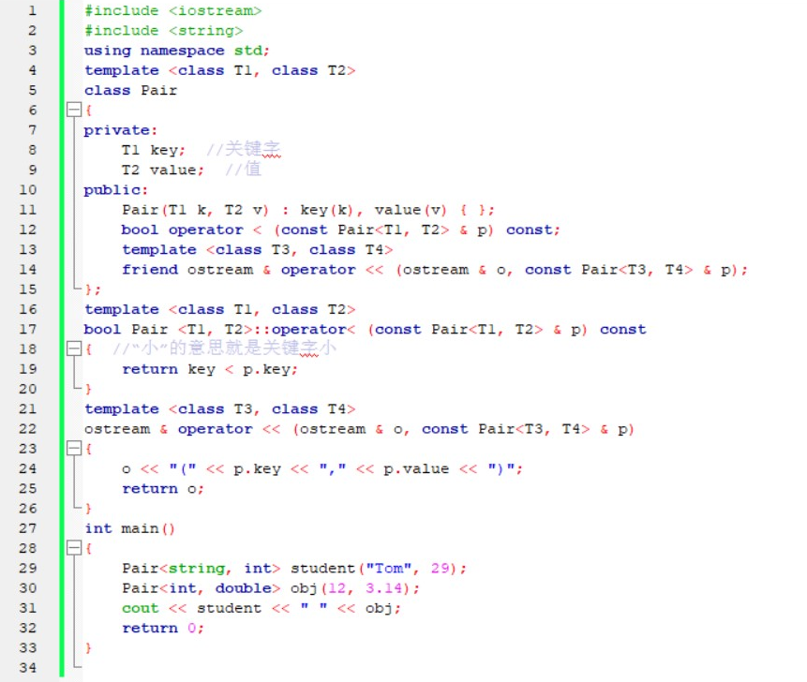

Slide 29
Templates and static Members
Non-template class
static data members shared between all objects
Template classes
Each class (int, float, etc.) has its own copy of static data members
static variables initialized at file scope
Each template class gets its own copy of static member functions

